Slide 1
Operating Systems
Lecture #10
OS Security
Răzvan Daniel ZOTA
Faculty of Cybernetics, Statistics and Economic Informatics
zota@ase.ro
https://zota.ase.ro/os

Slide 2
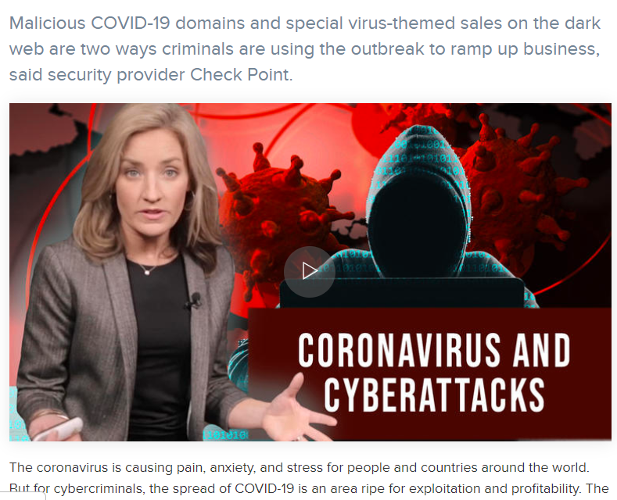
Today’s cybercrimes

Slide 3
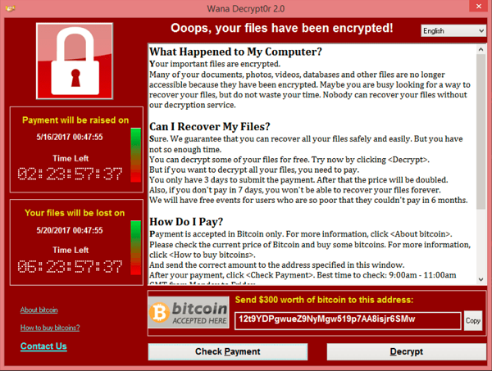
Cybercrimes from the (near) past
WannaCry (or WannaCrypt,^{[3]} WanaCrypt0r 2.0,^{[4][5]} Wanna Decryptor^{[6]}) is a ransomware program targeting the Microsoft Windows operating system. On Friday, 12 May 2017, a large cyber-attack was launched using it, infecting more than 230,000 computers in 150 countries, demanding ransom payments in the cryptocurrency Bitcoin in 28 languages.^{[7]} The attack has been described by Europol as unprecedented in scale.^{[8] (Wikipedia)}

Slide 4
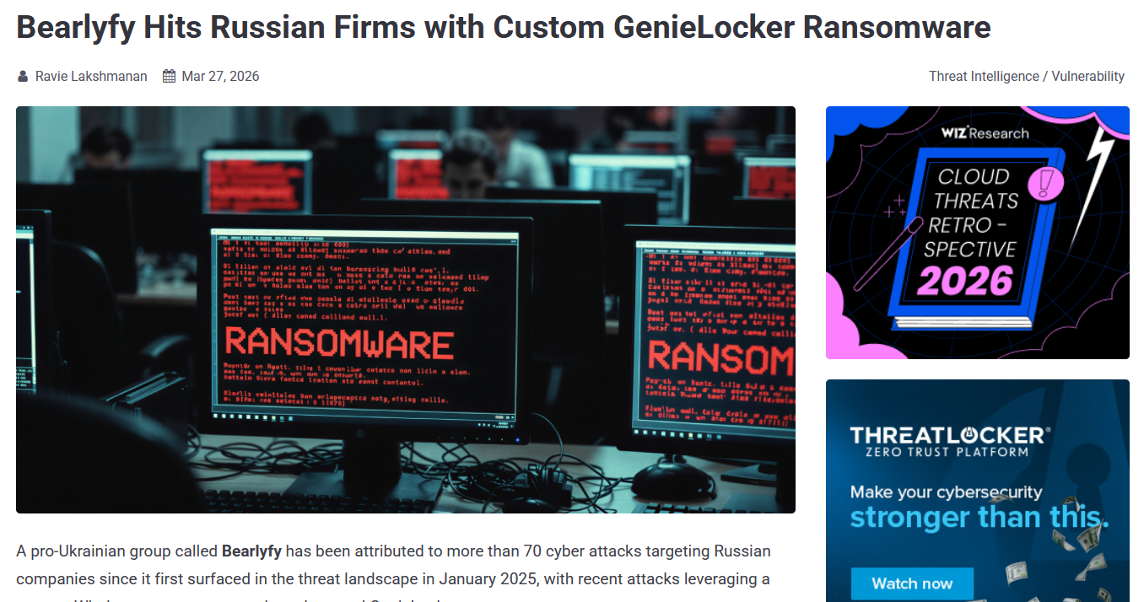
Ransomware attacks
https://thehackernews.com/2026/03/bearlyfy-hits-70-russian-firms-with.html

Slide 5
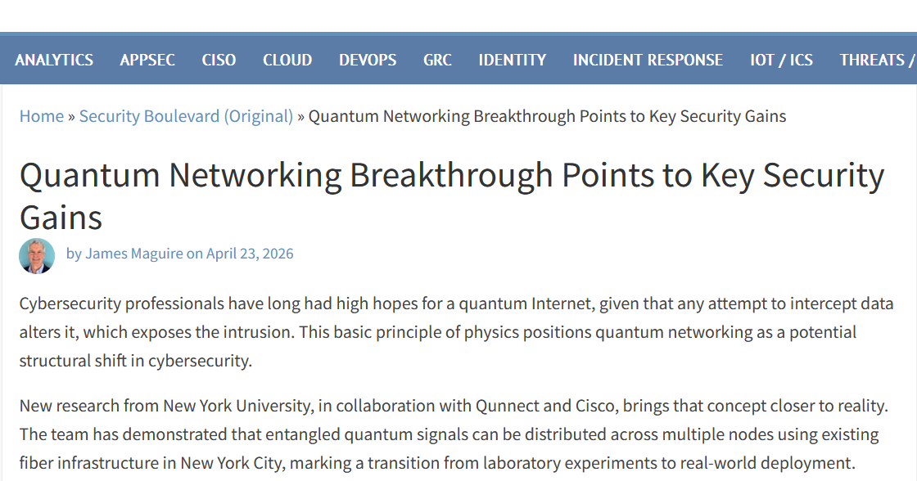
Cybersecurity News: Using Quantum Networking for Security
https://securityboulevard.com/2026/04/quantum-networking-breakthrough-points-to-key-security-gains//

Slide 6
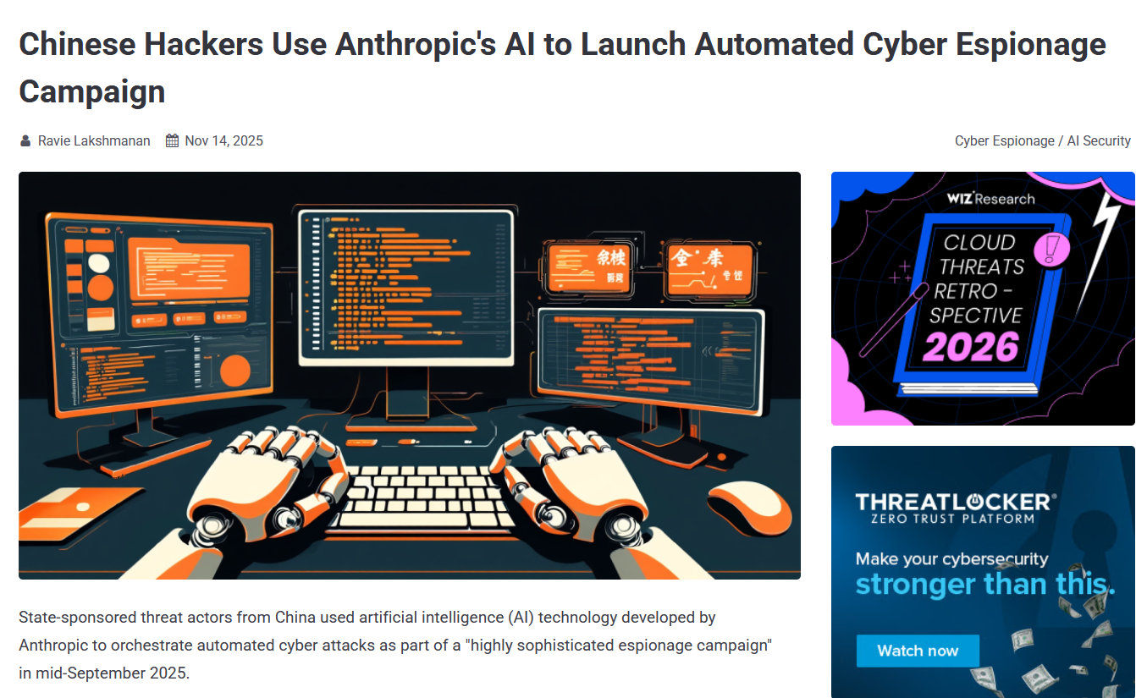
Cybersecurity News: AI vs. AI
https://thehackernews.com/2025/11/chinese-hackers-use-anthropics-ai-to.html

Slide 7
Introduction
Network/OS security represents a hot topic in the IT world
Security: warranty/steps that must be taken to protect a computer and the information stored on it
The need is for a balance between accessibility and security
The users prefer the first notion, administrators the second one!

Slide 8
Introduction (cont.)
The security level depends on multiple factors:
The business type of the company
- Governmental, juridical institutions, etc.
- Educational institutions (the students information is stored – marks, etc.)
- Hospitals, other medical institutions
- Companies in the military domain/ other institutions involved in state’s security
- Diverse companies/organizations which are gathering data under the confidentiality warranty, etc.
Types of data stored in the network/in the company’s computers
- Records about payment/personal information of the clients/customers
- Information about accountancy, taxes, etc.
- Commercial secrets (plans, drawings, sketches, recipes, business strategies, etc.)
Company’s management philosophy
- The company is considered as a big, happy, family...
- Information accessible only when is needed, only for the ones interested

Slide 9
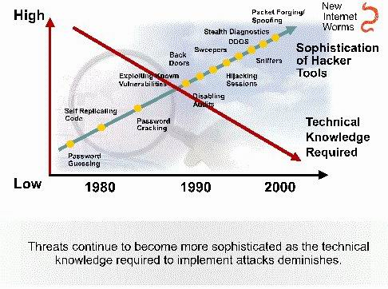
Attacks’ characteristic evolution
Notes:
Today, the Internet is a completely different network than it was in its early days. More and more people rely on it for their personal, financial, and business needs. Personal information needs to be protected. However, attack tools are becoming more sophisticated and highly automated, requiring less technical knowledge (than in the past) to use them.

Slide 10
Evolution of tools used by attackers in recent years
If we extended the graph to today, we would see that the two lines are moving even further apart:
Ransomware Explosion (2010 - 2020): Attacks have become a business model ("Ransomware-as-a-Service"). Attackers no longer need to write code; they "rent" software from elite groups and receive a share of the ransom paid by the victim.
The Age of Artificial Intelligence (AI): AI has taken sophistication to another level. We now have automated phishing (perfectly written messages, without grammatical errors) and deepfakes (fake video/audio calls that imitate the voice of an executive to authorize bank transfers).
Internet of Things (IoT): Sophistication now translates into attacking "smart" objects in the home (cameras, refrigerators), which have weak security.

Slide 11
Usernames and passwords
Normally, the system administrator will define a convention to establish usernames in a network (to access the OS).
Password rules are important, the control level will be accordingly with the necessary protection level.
A good security policy will contain the following:
- Passwords must expire after a specified time period.
- Passwords must contain letters, digits and special characters in order to not be easily broken.
The standard rule for passwords says that users must not write down the passwords on paper (or other support) and leave it with no supervision, or make it public.
- There must be defined rules concerning password expiry and account blocking (in the moment when an unsuccessful connection attempt was made).

Slide 12
Evolution of Security Threats
“Necessity is the mother of invention.”
As network security became an integral part of everyday operations, devices dedicated to particular network security functions emerged.
One of the first network security tools was the intrusion detection system (IDS), first developed by SRI International in 1984.
An IDS provides real-time detection of certain types of attacks while they are in progress. This detection allows network security professionals to more quickly mitigate the negative impact of these attacks on network devices and users. In the late 1990s, the intrusion prevention system (IPS) began to replace the IDS solution. IPS devices enable the detection of malicious activity and have the ability to automatically block the attack in real-time.

Slide 13
Evolution of Security Threats
In addition to IDS and IPS solutions, firewalls were developed to prevent undesirable traffic from entering prescribed areas within a network, thereby providing perimeter security.
In 1988, Digital Equipment Corporation (DEC) created the first network firewall in the form of a packet filter.
These early firewalls inspected packets to see if they matched sets of predefined rules, with the option of forwarding or dropping the packets accordingly.
Packet filtering firewalls inspect each packet in isolation without examining whether a packet is part of an existing connection.

Slide 14
Evolution of Security Threats
In 1989, AT&T Bell Laboratories developed the first stateful firewall.
Like packet filtering firewalls, stateful firewalls use predefined rules for permitting or denying traffic.
Unlike packet filtering firewalls, stateful firewalls keep track of established connections and determine if a packet belongs to an existing flow of data, providing greater security and more rapid processing.

Slide 15
Virtual Private Network (VPN)
Link encryption can be used in the sense that users have the “illusion” they are in a private network even when they actually use a public network. This approach is called virtual private network - VPN.
A firewall represents a device (hardware or software) for access control between two networks or network segments. The firewall is filtering all the traffic between the internal network (more protected) and the external network which is less protected.
The data transmission mode in a VPN is called encrypted communication channel or, for short, tunnel.

Slide 16
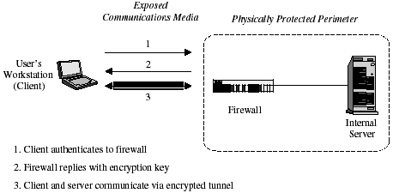
VPN Basic architecture

Slide 17
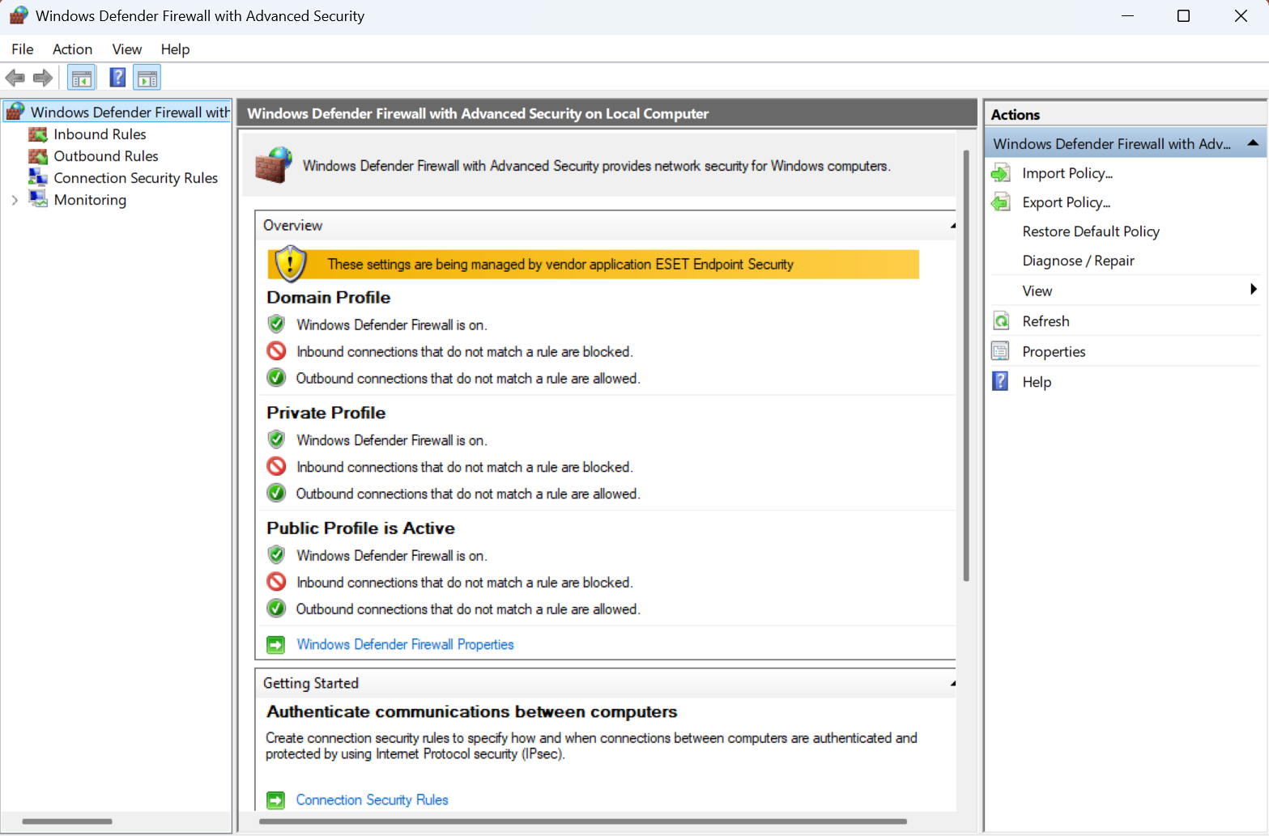
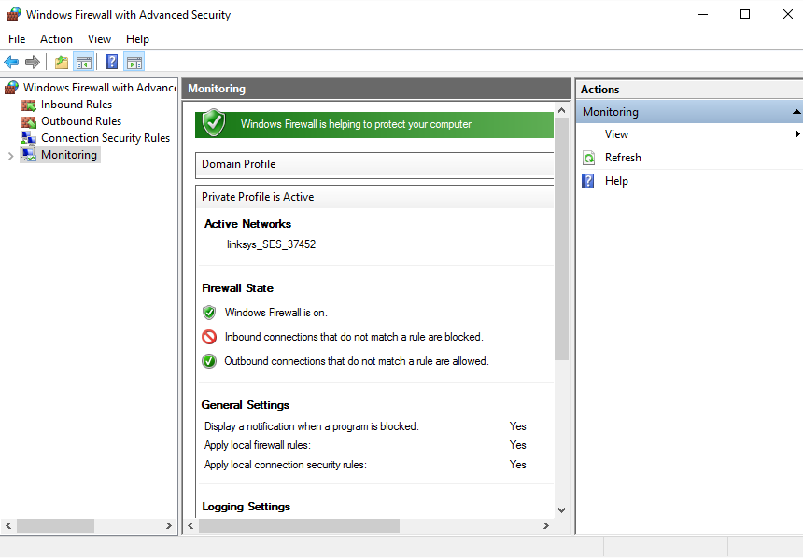
Windows 11 firewall

Slide 18
Linux firewalls
There are several firewall solutions for Linux. Today, the most used are:
nftables: it is the official successor to the old iptables. It is much faster, allows mixed rules (IPv4 and IPv6 in the same list), and is the default standard in most distributions (Debian 12+, RHEL 9+, Ubuntu 24.04+).
iptables : Although considered "legacy", it is still widely used in legacy infrastructures, but most systems now use a compatibility layer called iptables-nft.

Slide 19
Conclusions
The OS security represents an important part of the network security. When we must implement the OS security we must take into consideration the following:
Defining an acceptable security policy for the company’s network; here is defined what is permitted and what is not permitted in the company’s network.
The security policies regarding passwords must be enforced and respected, including an expiration date, blocking rules and using a combination of letters, digits and special characters, imposing a minimum length for these.

Slide 20
Conclusions (2)
The security threats form the Internet are including hackers, crackers, viruses and worms. Although a hacker can produce damage, by definition a cracker is the one who enters a system to produce a damage or to steal information.
A virus or a worm can also create substantial damages. A worm is not attaching to files but remains active in memory auto-replicating.
Good security policies help minimizing threats. The employees and trust users have access to critical information about the network (including passwords) and can facilitate commercial espionage.

Slide 21
Conclusions (3)
System administrators must protect the computers against data theft and destruction and “denial of service” attacks. Moreover, the “Distributed Denial of Service (DDoS)” attacks, originating from multiple sources, can be extremely difficult to counter attack.
In order to keep the OS updated, the security patches and upgrades must be installed permanently as soon as they are available.
An Internet firewall represents a good protection against the exterior attacks.
Other important security instruments are the VPNs, IPSs (IPS - Intrusion Prevention System) that can be used in combination with a firewall solution.

Slide 22
Modern security threats
The threat landscape has changed radically since the 2000s:
Ransomware-as-a-Service (RaaS):
Attackers rent ransomware infrastructure — they don't have to be programmers anymore
LockBit, BlackCat/ALPHV, Clop — organized groups as legal companies
Double extortion: encrypts data and threatens to publish it
Supply Chain Attacks:
SolarWinds (2020): malicious code injected into legitimate update → 18,000 organizations compromised
Log4Shell (2021): vulnerability in Log4j, used in millions of Java applications
XZ Utils (2024): backdoor planted for 2 years in the popular Linux library
AI-Powered Attacks:
LLMs used for personalized phishing on a massive scale
Deepfake audio/video for impersonating managers (CEO fraud)
Prompt injection in AI systems connected to sensitive data

Slide 23
MFA and Zero Trust Architecture
Passwords alone are no longer enough — 81% of breaches involve compromised passwords (Verizon DBIR 2023)
MFA — Multi-Factor Authentication:
Something you know (password) + something you have (phone/token) + something you are (biometrics)
TOTP (Time-based OTP) — Google Authenticator, Authy, Microsoft Authenticator
FIDO2/WebAuthn — hardware keys (YubiKey) or biometrics = phishing-resistant
Passkeys (2023) — replace passwords completely, supported by Google, Apple, Microsoft
Zero Trust Architecture:
Main principle: "Never trust, always verify" — no device is trusted by default
Micro-segmentation: each application is isolated, there is no trusted internal network
Continuous checking: identity + device + context on each request
Adopted by Google (BeyondCorp), Microsoft (Entra ID), NIST SP 800-207

Slide 24
Secure Boot, TPM 2.0 and boot security
The chain of trust at boot — attackers target lower and lower levels:
UEFI Secure Boot:
Verify the bootloader's digital signature at startup
Prevents bootkits and rootkits from installing under the OS
Required for Windows 11; also supported on Linux (shim + signed GRUB)
TPM 2.0 (Trusted Platform Module):
Dedicated security hardware chip — stores cryptographic keys in isolated hardware
BitLocker (Windows) and Linux LUKS can use TPM for secure automatic decryption
Attestation: TPM certifies system status — detects changes at boot
Checking in Linux:
$ mokutil --sb-state # Secure Boot activ?
$ tpm2_getcap properties-fixed # TPM capabilities
$ systemd-cryptenroll --list-devices # LUKS cu TPM
Checking in Windows:
PS> Confirm-SecureBootUEFI # True/False
PS> Get-TpmEndorsementKeyInfo # TPM state

Slide 25
SELinux and AppArmor —Mandatory Access Control security
Beyond classic Unix permissions (DAC), Linux offers MAC (Mandatory Access Control):
SELinux (Security-Enhanced Linux):
Developed by NSA, default on RHEL/CentOS/Fedora
Granular policies: which processes can access which files, ports, sockets
Even root is restricted by SELinux policies
$ getenforce # Enforcing/Permissive/Disabled
$ sestatus # SELinux state
AppArmor:
Default on Ubuntu, Debian — easier to configure than SELinux
Per-application profiles: what files and capabilities are allowed
$ aa-status # AppArmor active profiles

Slide 26
EDR, XDR and SIEM — modern threat detection
Classic IDS/IPS systems have been replaced by much more advanced solutions :
EDR — Endpoint Detection and Response:
Continuous behavioral monitoring of endpoints (not just signatures)
Detects zero-day attacks and abnormal behavior
Examples: CrowdStrike Falcon, Microsoft Defender for Endpoint, SentinelOne
XDR — Extended Detection and Response:
Correlate data from email + endpoint + network + cloud simultaneously
Reduce Mean Time to Detect (MTTD) from days to hours or minutes
SIEM — Security Information and Event Management:
Aggregation of logs from across the infrastructure → correlation → alert
Examples: Splunk, Microsoft Sentinel, Elastic SIEM (open source)
Open source alternative on Linux:
$ sudo apt install wazuh-agent # SIEM/EDR open source
$ sudo journalctl -f | grep -i 'failed\|error\|denied'
$ sudo last | head -20 # last authentications
$ sudo faillock --user student # login failures

Slide 27
nftables — Modern Linux firewall
(replacement for IPtables)
IPtables is deprecated and replaced by nftables since Linux kernel 3.13 (2014), default in Debian 10+, RHEL 8+:
nftables advantages compared with IPtables:
Unified syntax (replaces iptables, ip6tables, arptables, ebtables)
Better performance by batch evaluation and JIT compilation
Native sets and maps for complex rules without external scripts
Examples of nftables commands:
$ nft list ruleset # all rules
$ nft add table inet filter
$ nft add chain inet filter input { type filter hook input priority 0 \; }
$ nft add rule inet filter input tcp dport 22 accept # permits SSH
$ nft add rule inet filter input drop # blocking the rest
$ nft list ruleset > /etc/nftables.conf # save the rules
Windows 11 Firewall:
PS> Get-NetFirewallRule | Where-Object Enabled -eq True | Select DisplayName
PS> New-NetFirewallRule -DisplayName 'Block Telnet' -Protocol TCP -LocalPort 23 -Action Block
PS> Set-NetFirewallProfile -Profile Domain,Public,Private -DefaultInboundAction Block

Slide 28
OS-level encryption
Modern encryption operates at multiple levels in the OS:
Full Disk Encryption (FDE):
Windows: BitLocker (TPM + PIN) — integrated in Windows 10/11 Pro
Linux: LUKS (Linux Unified Key Setup) with dm-crypt
macOS: FileVault 2 (based on APFS with native enryption)
File/directory level encryption:
# Linux — eCryptfs (director criptat)
$ ecryptfs-setup-private # encryption ~/Private
# Linux — fscrypt (ext4, F2FS native encryption)
$ fscrypt encrypt /home/student/secret/
Recommended modern algorithms :
AES-256-GCM — standard symmetric encryption
ChaCha20-Poly1305 — fast alternative on devices without hardware AES
RSA-4096 / Ed25519 — asymmetric encryption / digital signatures
SHA-3 / BLAKE3 — modern hashing (SHA-1 and MD5 are compromised)

Slide 29
Modern authentication practices and new password policies
Password policies have changed dramatically — NIST SP 800-63B:
What NIST no longer recommends (outdated practices):
Mandatory periodic password expiration (forces weak passwords: Password1! → Password2!)
Artificial complexity (uppercase+numbers+special → users choose Pa$$w0rd)
Security questions (mother's maiden name = public information)
What NIST recommends now:
Minimum length 8 characters, no maximum limit
Passphrases: 'white-dog-red-wall’ better than 'P@$$w0rd123’
Check against lists of compromised passwords (HaveIBeenPwned API)
Mandatory MFA for critical accounts
Recommended password managers:
Bitwarden (open source,), 1Password, KeePassXC
Linux verification — password policy:
$ cat /etc/pam.d/common-password # PAM policy
$ sudo apt install libpam-pwquality
$ chage -l student # password expiry

Slide 30
Recent major incidents and lessons learned
The most important recent security incidents:
SolarWinds (2020) — supply chain:
Legitimate update of an IT product compromised by state actors (Russia/APT29)
Lesson: zero trust chiar pentru vendor-i de securitate; software bill of materials (SBOM) – SBOM: a formal, structured inventory of all components, open-source and third-party libraries, and dependencies that make up an application.
Log4Shell/CVE-2021-44228:
CVSS score 10.0 — vulnerability in Java library used in 3 billion devices
Lesson: Software Composition Analysis (SCA) mandatory - an automated process that identifies open-source components, third-party dependencies, and license risks within an application's codebase ; dependency inventory also mandatory.

Slide 31
Recent major incidents and lessons learned (cont.)
MOVEit Transfer (2023) — zero-day in a commercial product:
The Clop Group stole data from 2,500+ organizations in a few days
Lessons: isolation of critical data; principle of least privilege
CrowdStrike (2024) — faulty update:
EDR sensor update → 8.5 million Windows PCs with BSOD in 90 minutes
Lessons: Insufficient Testing, No Rollback Mechanism: Once the faulty update was deployed, there was no efficient way to roll it back, Lack of User Control - good product design should consider user autonomy and control over updates, Manual Remediation Required.

Slide 32
Conclusion
Main conclusion: security is not a product — it is a continuous process

Slide 33
Updated resources — OS security
CVE and vulnerabilities:
NVD (National Vulnerability Database):
https://nvd.nist.gov
CVE Details — statistics and trends:
https://www.cvedetails.com
Standards and guides:
NIST Cybersecurity Framework:
https://www.nist.gov/cyberframework
OWASP Top 10:
https://owasp.org/Top10
Linux Security:
Linux Security Guide:
https://www.kernel.org/doc/html/latest/security/index.html
SELinux User and Admin Guide:
https://access.redhat.com/documentation/en-us/red_hat_enterprise_linux/9/html/using_selinux
Windows Security:
Microsoft Security Documentation:
https://learn.microsoft.com/security
Știri securitate zilnice:
BleepingComputer, The Hacker News, Krebs on Security, SANS Internet Stormcenter

